Slide 1
Analysis of Chicago Crimes
Danielle Líbano
Hugo Valdrez
Luís Pinto
Vinícius Batista

Slide 2
Index
Problem Definition
Data Understanding
Data Preparation
Data Visualization
Association Rules
Link Analysis
Text Processing
Descriptive Modelling
Predictive Modelling
Conclusions

Slide 3
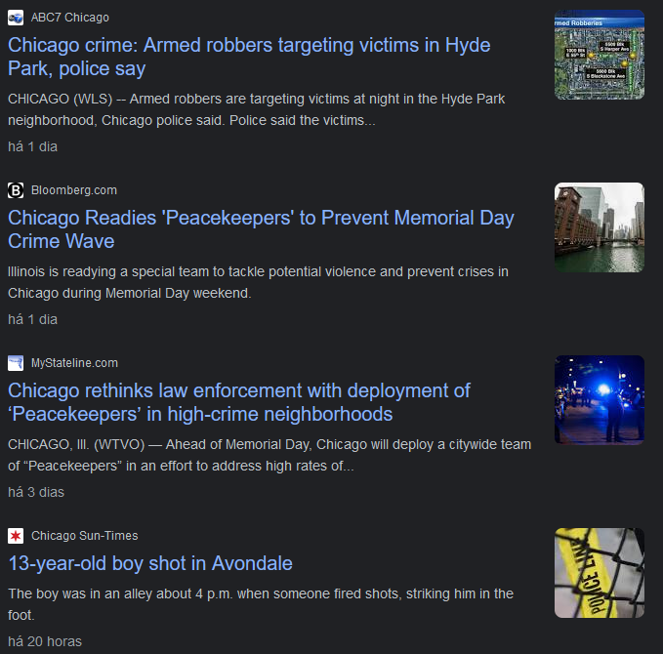
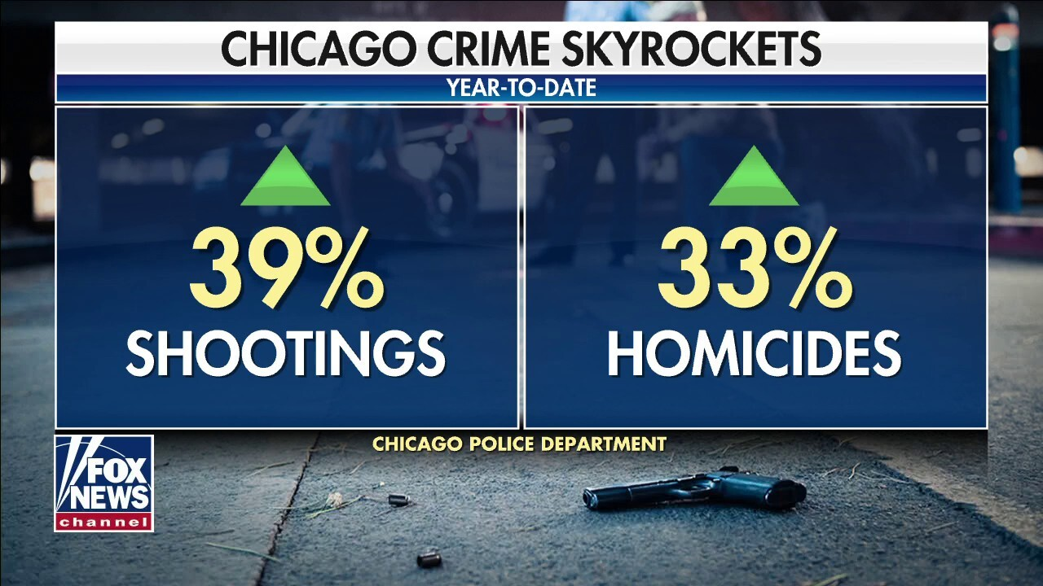

Problem Definition
Crime is a challenge that societies face, with its consequences affecting both individuals and communities. The ability to gain insights into the patterns and characteristics of criminal activities is important for the understanding of why it is happening and what can be done.
Fig 1-3. Chicago Crimes News.

Slide 4

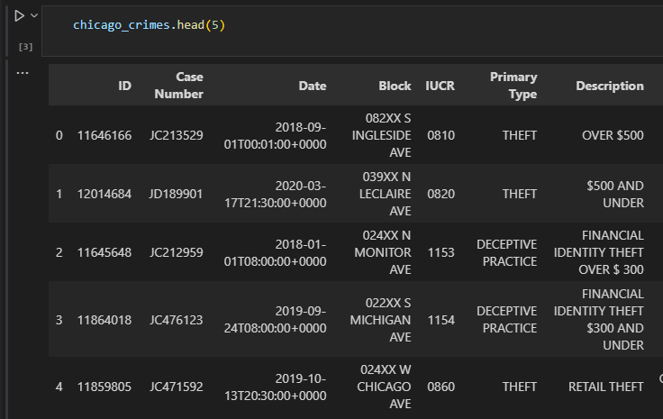

Data Understanding
Getting a first insight about what we had in our hands:
How big is it?
What columns are there?
What do they mean?
Fig 4. Tools
Fig 5. Dataset

Slide 5
Data Preparation
Data Correction & Cleaning
Data Collection
Feature Engineering

Slide 6
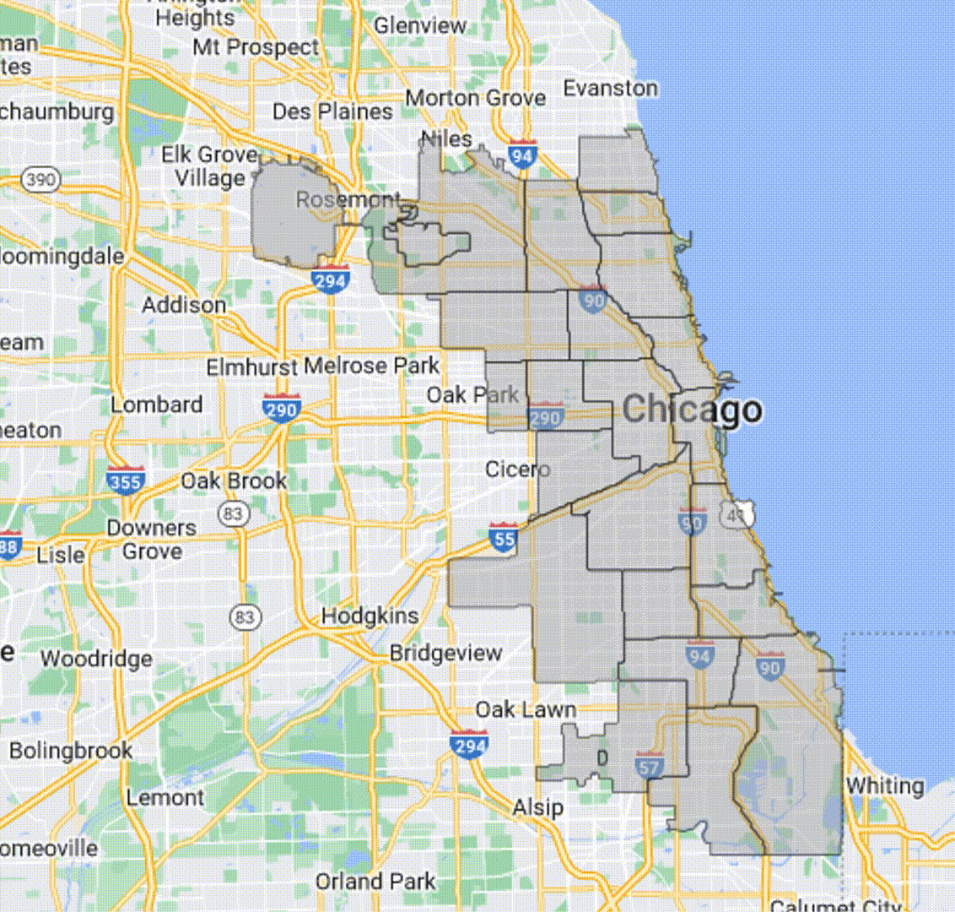
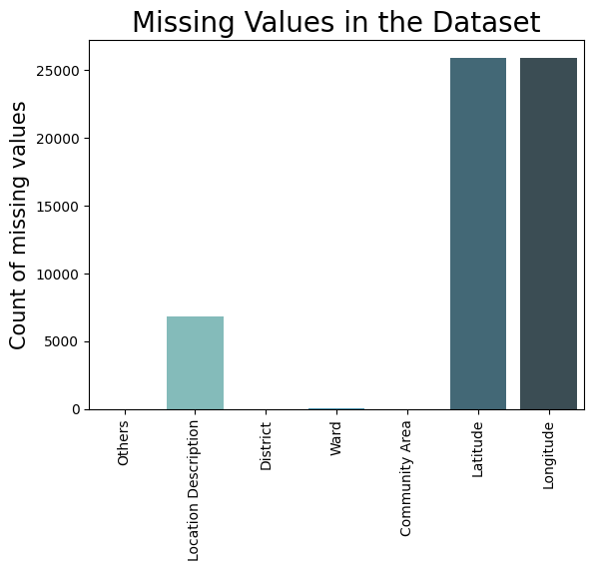
Data Preparation
Data Correction & Cleaning
Null values
District Inconsistencies
Coordinates not belonging to Chicago
Ward/Community not up to date
Fig 7. Dataset
Fig 6. Missing Values

Slide 7

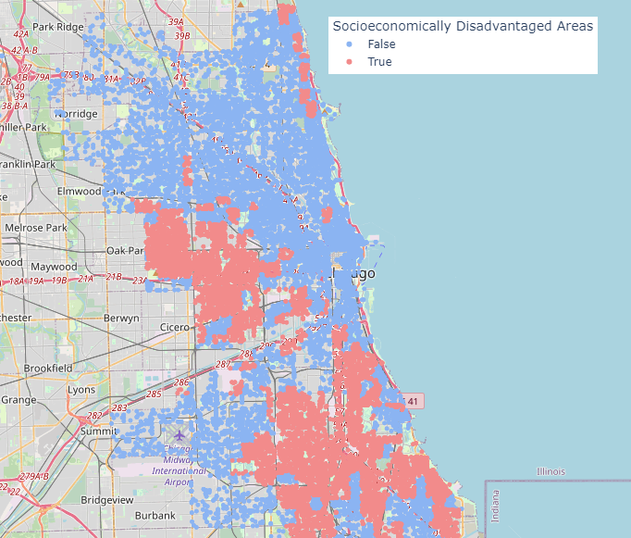
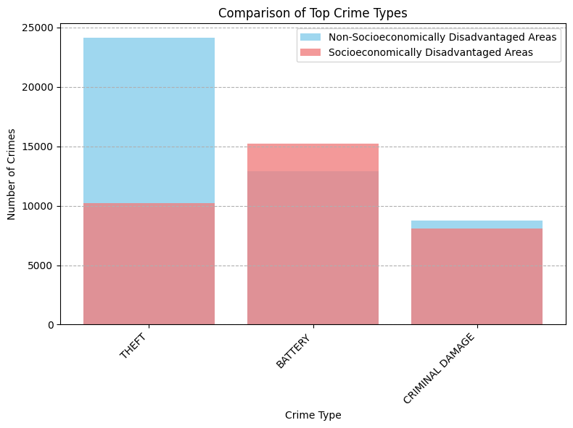
Data Preparation
Data Collection
What if we had X feature?
Is there a correlation between X feature and Y type of Crime?
Can we find anything online?
Fig 8. Socioeconomic Distribution
Fig 9. Socioeconomic Distribution by Crime

Slide 8
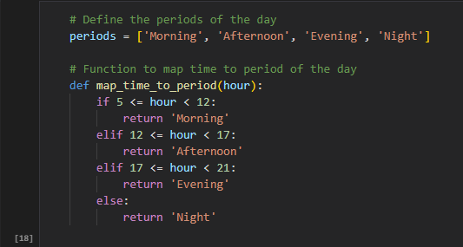
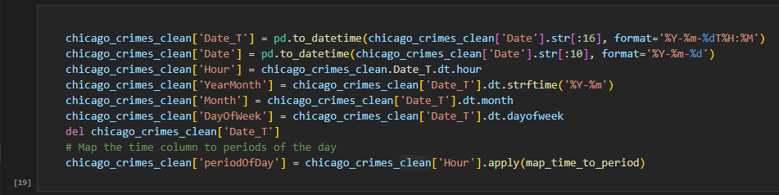
Data Preparation
Feature Engineering
Hour
YearMonth
Month
DayOfWeek
periodOfDay
Fig 11. Period of the Day
Fig 10. Feature Creation

Slide 9
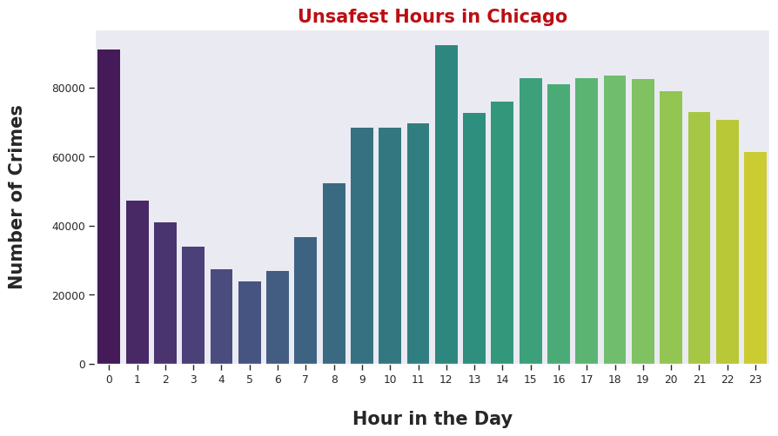
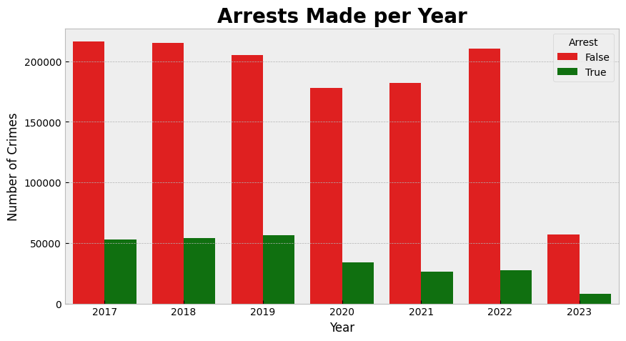
Data Visualization
It was time to question!
What was/is the crime behaviour?
What are the crimes with more occurrences?
How many arrests are there?
Is there a "worst hour" to go out?
Fig 13. Crimes by Hour
Fig 12. Comparisson of Arrests

Slide 10
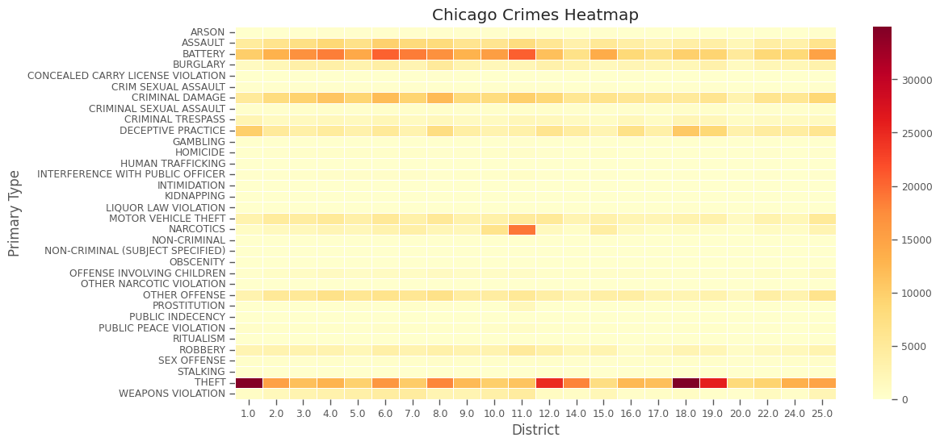
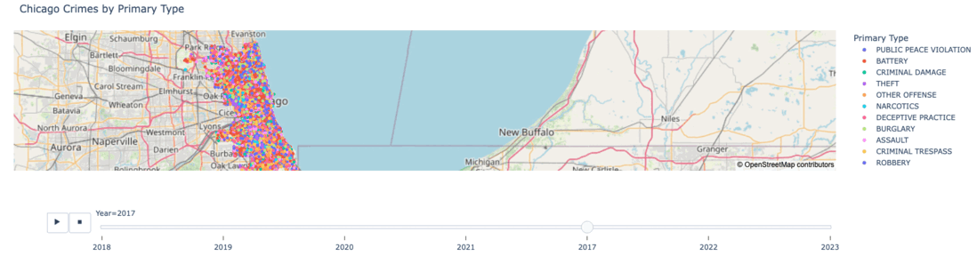
Data Visualization
Fig 14. Heatmap of crimes by district
Fig 15. Crimes occurences over the years

Slide 11
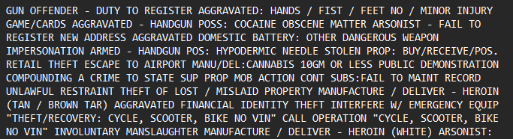
Text Processing
The Description and Location were selected and transformed into a plain text:
Fig 16. Description and Location
Then, the following steps were applied:
Special characters were removed.
The text was tokenized.
Stop words were removed.
Lemmatization was performed.
Only unique words were selected.
The words were sorted by their size.

Slide 12
Text Processing
Vector: ["transportation","establishment","entertainment","manufacturing","construction",
"convenience", [...]]
The pre-trained GloVe model.
Examples of clusters:
'beauty': ['barbershop', 'beauty', 'barber', 'salon'],
'church': ['synagogue', 'worship', 'church'],
'entertainment': ['entertainment', 'theater', 'movie', 'bowling',],
'police': ['police', 'jail', 'fire']

Slide 13
Text Processing
- The similarity between the description_doc and each keyword was checked using spaCy's similarity method with 0.9 score
- The partial ratio between the description and keyword was calculated, and if it was above or equal to 90, the corresponding key was returned.
- It was checked if any word from the word_list was present in the tokens list
Result: 32 Location and 63 description​
​

Slide 14
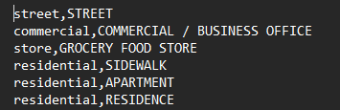
Text Processing
- The similarity between the description_doc and each keyword was checked using spaCy's similarity method with 0.9 score
- The partial ratio between the description and keyword was calculated, and if it was above or equal to 90, the corresponding key was returned.
- It was checked if any word from the word_list was present in the tokens list
Result: 32 Location and 63 description​
​
Fig 17. Sample of text processing

Slide 15
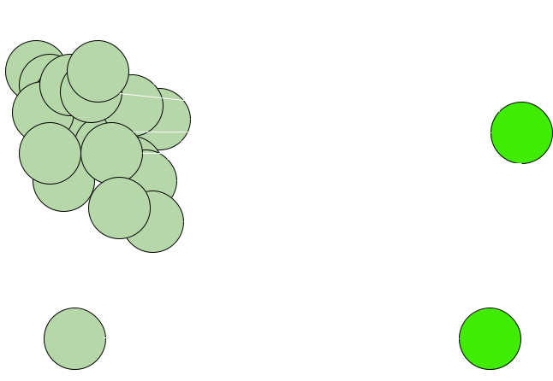
Link Analysis
Nodes: PrimaryType, Description, Location, Arrest, Domestic, Year, Month, Weekday and WeekMonth
Fig 18. Link Analysis Network

Slide 16
Link Analysis
Graph Properties:
- 141 nodes and 5676 edges
- Density: 0.575
- Diameter: 2
Node Importance:
- Eigenvector centrality and PageRank scores: ArrestFalse, DomesticFalse, residential, Fourth, Night, and Afternoon

Slide 17
Link Analysis
Betweenness centrality:
- Cemetery, department, WEAPONS VIOLATION, explosive, and secure.
Closeness centrality:
- "murder" and "bridge."
Community Detection:
- Five communities were identified
- One community of interest: "BATTERY," "residential," "sexual," "abuse," and "DomesticTrue."

Slide 18
Association Rules
It was time to question, again!
Are there any related crimes?
Maybe a relationship between some of them?
Could it be used as a preventing action by authorities?

Slide 19
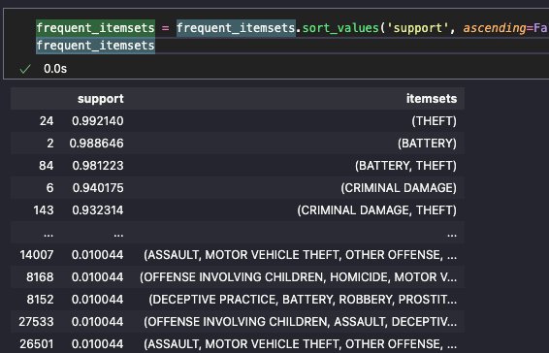
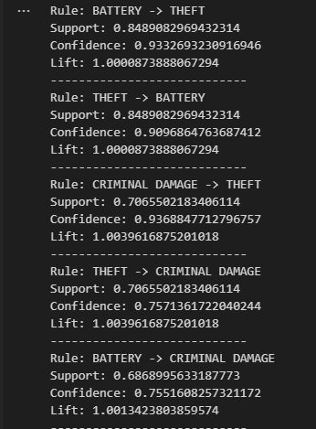
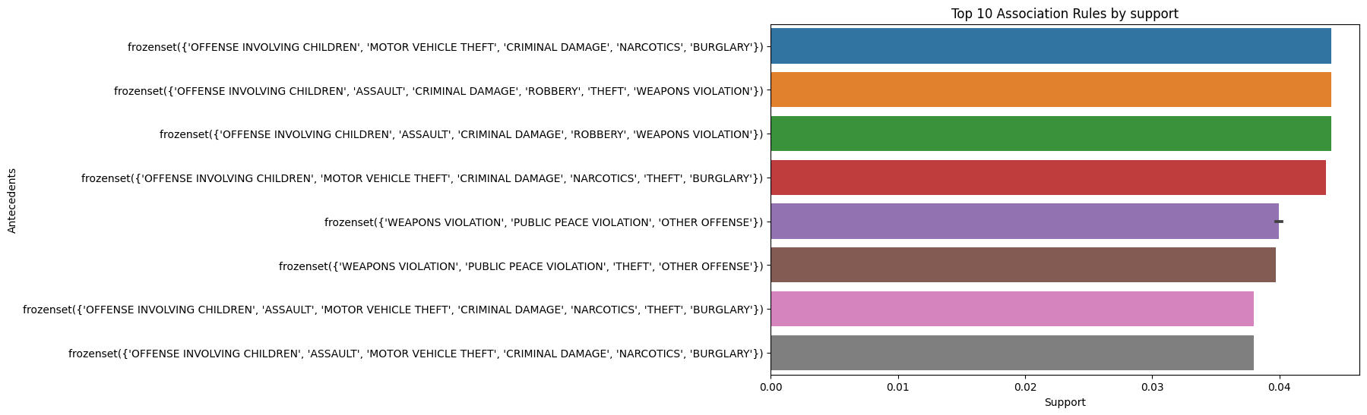
Association Rules
Two Algorithms
Apriori
FP-Growth
Fig 19. Itemset Sorted
Fig 21. Association Rules by Support
Fig 20. Association Rules Sample

Slide 20
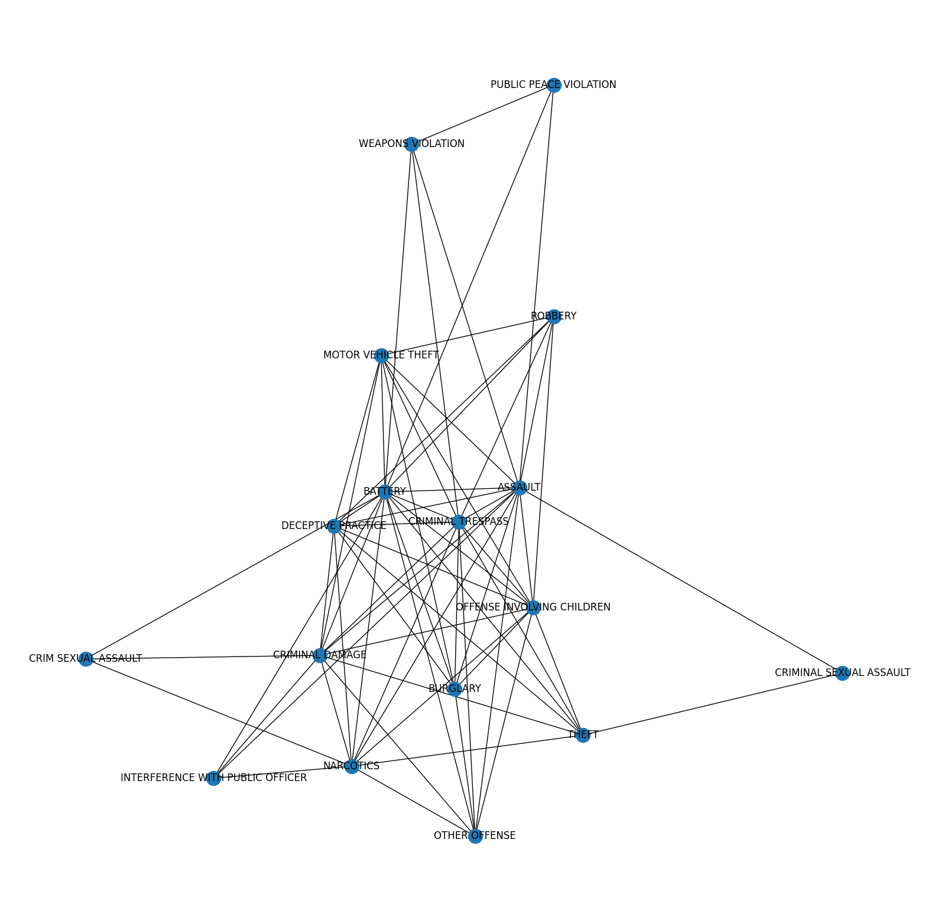
Association Rules
Network
Fig 22. Network Graph from Association Rules

Slide 21
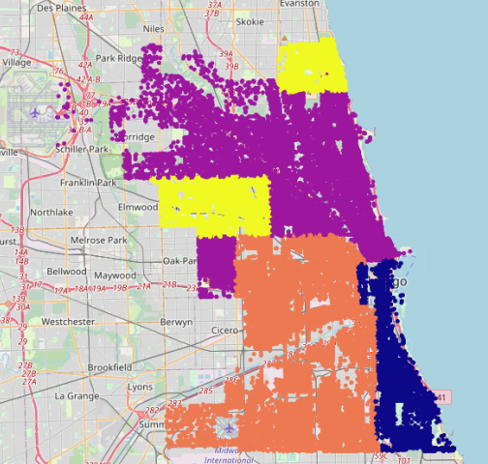
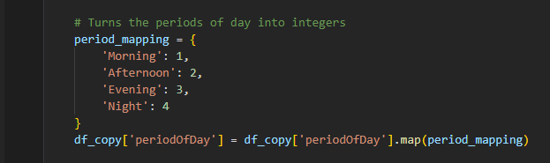
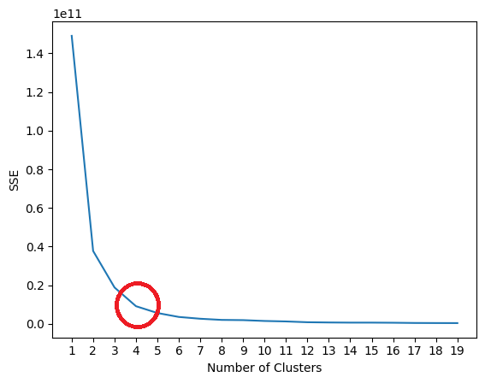
Descriptive Modelling
3 Steps:
Data Processing
The Elbow Method
Model
Fig 23. Conversion of Periods
Fig 25. Clusters on Map
Fig 24. Elbow Method

Slide 22
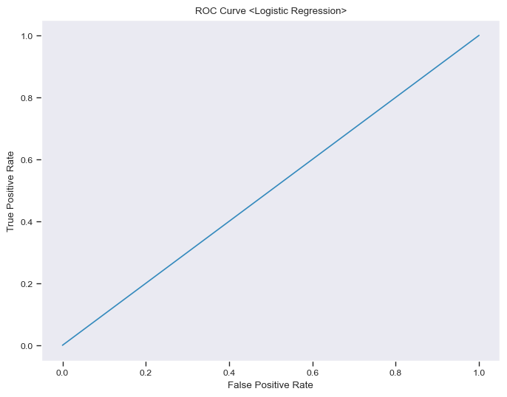
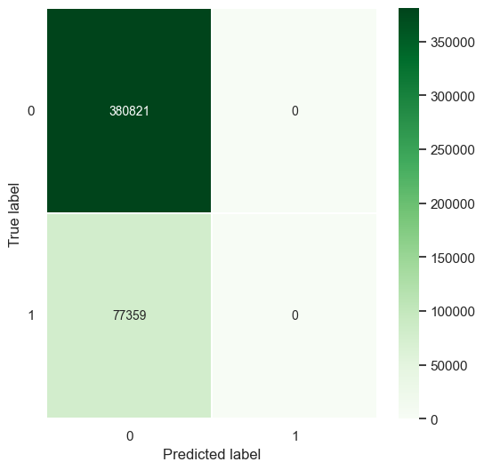
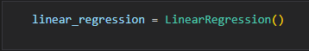
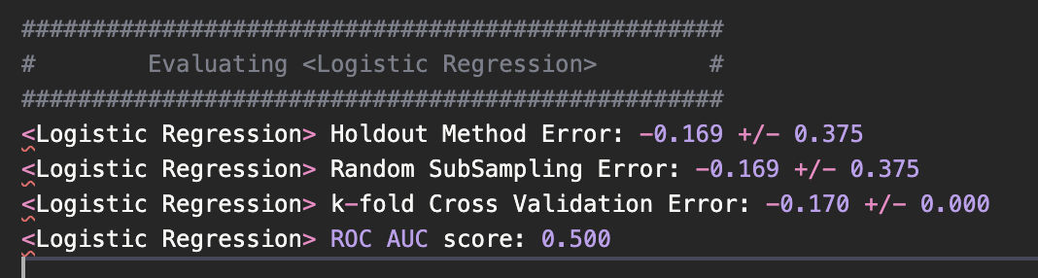
Predictive Modelling
Logistic Regression
Definição do modelo.
Avaliação do modelo.
Fig 26. Definição do modelo
Fig 27. Houldout, RSE and Kfold values
Fig 28. Roc Curve
Fig 29. Confusion Matrix

Slide 23
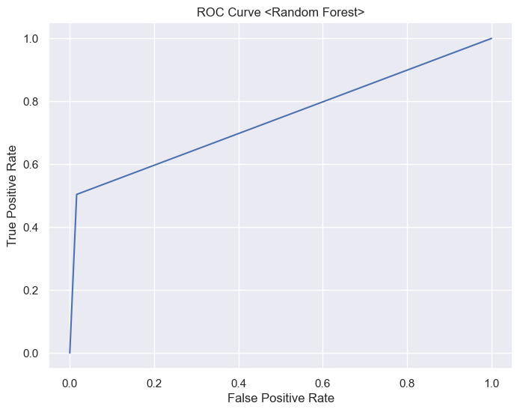
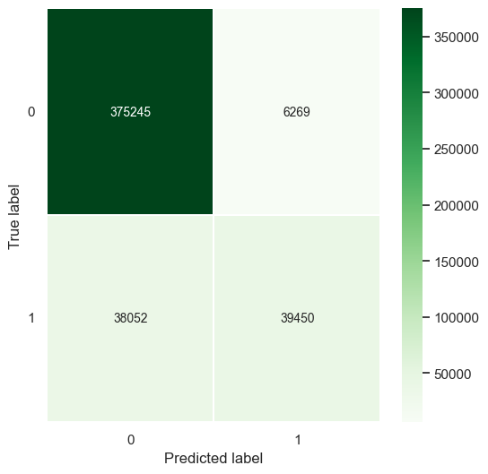
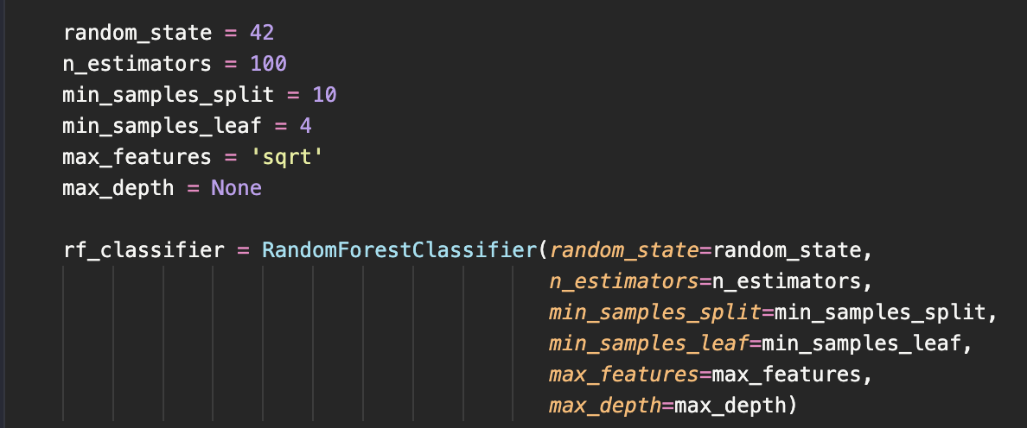
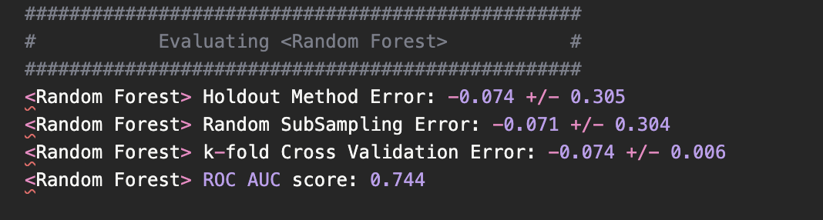
Predictive Modelling
Random Forest
Definição do modelo.
Avaliação do modelo.
Fig 30. Definição do modelo
Fig 32. Roc Curve
Fig 33. Confusion Matrix
Fig 31. Houldout, RSE and Kfold values

Slide 24
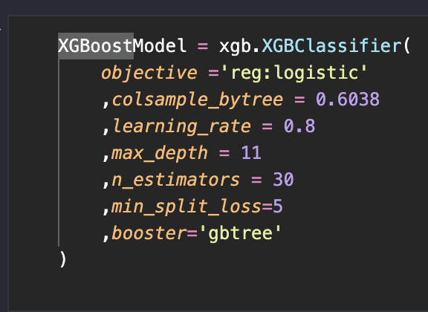
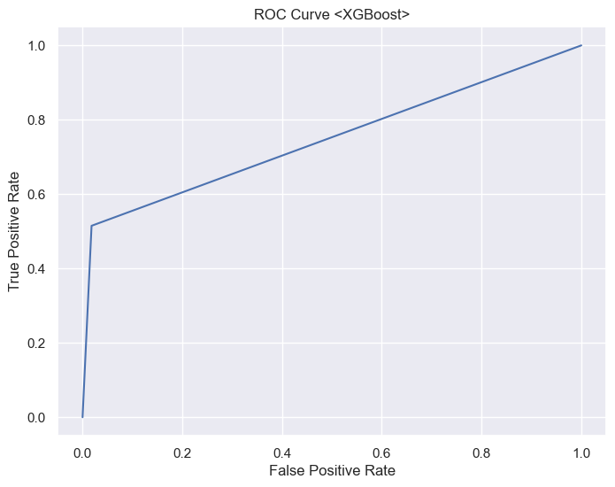

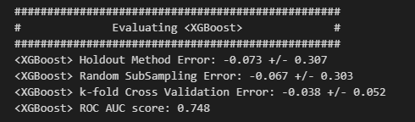
Predictive Modelling
Definição do modelo.
Avaliação do modelo.
XGBoost
Fig 34. Definição do modelo
Fig 35. Houldout, RSE and Kfold values
Fig 36. Roc Curve
Fig 37. Confusion Matrix

Slide 25
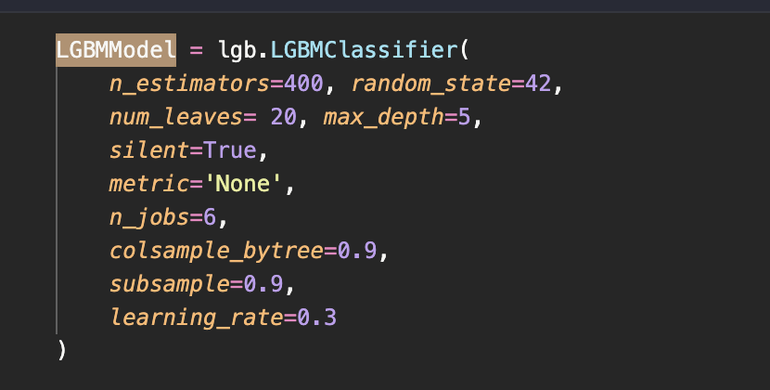
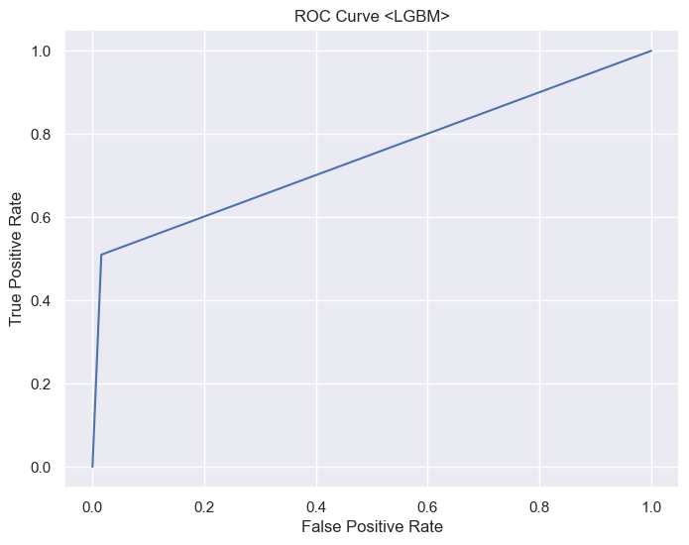

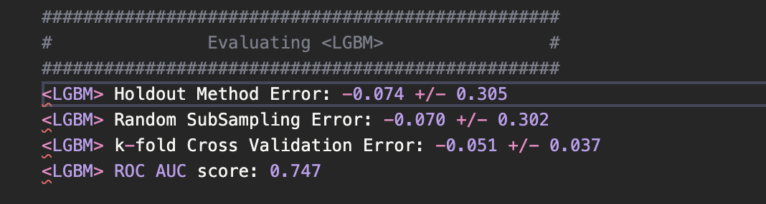
Predictive Modelling
Definição do modelo.
Avaliação do modelo.
LGBM
Fig 38. Definição do modelo
Fig 39. Houldout, RSE and Kfold values
Fig 40. Roc Curve
Fig 41. Confusion Matrix

Slide 26
Conclusions
Evaluation:
We discovered relationships between stealing, battery, criminal damage and assault, which may be explained by their frequency as the most common crimes.​
​ Our findings emphasize the importance of considering peak crime hours, temporal trends and seasonal fluctuations when allocating resources and arranging patrols. ​
Limitations:
Dataset size
Future Work:
Further KMeans exploration
Other forecasting features
Expanded Association Rules
Use of unsupervised learning

